Slide 1
Amazon Sales Report — Performance Analysis Using Python & Power BI
- A comprehensive analysis of Amazon sales performance, category trends, and business insights powered by data analytics.
Dhanujasri Sagadevan
Data Analyst | Portfolio Project 2025
Python · Pandas · Power BI · BeautifulSoup · GitHub

Slide 2

Executive Summary
Conducted a comprehensive sales performance analysis of Amazon dataset to identify trends, top-performing categories, and seasonal sales patterns.
Web-scraped product data including price, ratings, category, and customer reviews using BeautifulSoup and Requests in Python.
Performed data cleaning, preprocessing, and exploratory data analysis (EDA) to uncover performance metrics and anomalies.
Built an interactive Power BI dashboard for real-time tracking of revenue, sales distribution, and customer sentiment.
Derived data-driven insights to optimize product strategy, pricing, and inventory planning.

Slide 3
Objective & Problem Statement
🎯Objective
The primary objective of this project is to conduct a comprehensive Amazon Sales Performance Analysis using Python and Power BI, enabling clear visibility into revenue patterns and category dynamics.
Specific Goals
Collect product and sales data through web scraping using BeautifulSoup and Requests libraries.
Clean and preprocess the dataset to ensure accuracy and consistency.
Analyze sales, ratings, and category trends using Python-based EDA.
Visualize performance metrics and KPIs through a Power BI dashboard.
Derive actionable insights for optimizing pricing, stock management, and marketing focus.
⚠️Problem Statement
Amazon processes millions of transactions daily across diverse product categories. However, identifying which categories and products drive sales performance, seasonal revenue variations, and customer behavior trends remains a complex challenge without structured data analysis.
Despite abundant data, businesses often lack clear visibility into category-level sales trends, pricing effectiveness, and performance metrics — leading to suboptimal inventory, pricing, and marketing decisions.
In short: There’s a need for a data-driven approach to uncover meaningful sales insights and enhance business performance decisions.

Slide 4
Data Collection Process
Data Source
Data was scraped from Amazon’s product listings across categories such as Electronics, Home Appliances, and Accessories.
Data Extraction
Used Python (BeautifulSoup, Requests, Pandas) to extract:
Product Name ,Category ,Price ,Rating ,Reviews Count ,Availability
Data Cleaning
Removed duplicates and missing values
Standardized price and category formats
Ensured consistent numeric values for analysis
✅ Final output: A clean, structured dataset ready for EDA and visualization.
SOURCE
EXTRACTION
CLEANING

Slide 5
Data Preparation & Exploration
Key Findings
Top Revenue Categories: Electronics and Home Appliances drove the highest sales.
Price Trends: Products priced mid-range (₹1,000–₹5,000) had the highest sales volume.
Customer Ratings: Products with ≥4.5 stars dominated top-selling items.
Review Count Correlation: High review count correlated with higher sales.

Slide 6
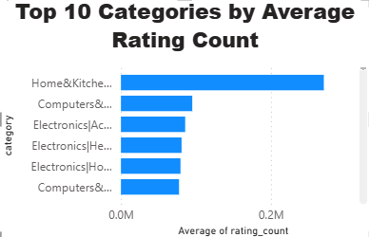
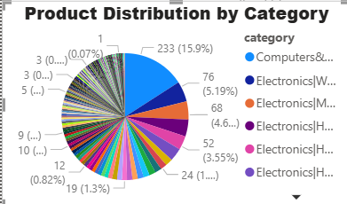
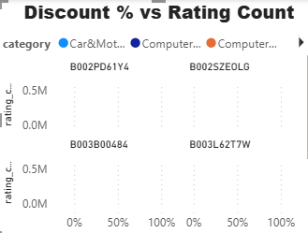
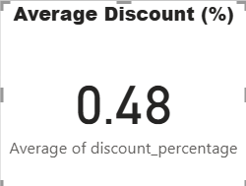
Sales Performance & Category Insights — Power BI Dashboard
Key Insights:
High-rated electronics drive majority of revenue.
Mid-priced products attract maximum buyers.
Seasonal peaks align with major discount periods.
Top-selling categories dominate inventory strategy decisions.

Slide 7
Key Insights & Business Implications
Business Implications
Inventory Optimization: Prioritize stocking and restocking of high-demand categories.
Pricing Strategy: Maintain competitive pricing in mid-range segments to sustain momentum.
Marketing Focus: Amplify campaigns for top-rated and high-reviewed products.
Customer Experience: Encourage review feedback loops to drive credibility and trust.
Forecasting: Plan promotions and logistics ahead of known sales peaks.
Key Insights
Electronics and Home Appliances dominate total revenue, accounting for the highest profit contribution.
Mid-range priced products (₹1,000–₹5,000) deliver optimal sales volume and steady revenue.
High-rated products (≥4.5 stars) outperform in both conversion and retention rates.
Customer engagement (reviews) strongly correlates with product success.
Seasonal peaks occur during major discount and festive periods, indicating high marketing ROI opportunities.

Slide 8
Conclusion & Recommendations
Conclusion
The Amazon Sales Analysis successfully revealed key sales patterns, pricing effectiveness, and category performance drivers using Python (for data collection & EDA) and Power BI (for visualization & insights).
Data-driven exploration showed that:
Electronics & Home Appliances are top revenue contributors.
Mid-range pricing delivers optimal conversions.
High-rated and frequently reviewed products dominate sales performance.
Seasonal promotions directly influence customer purchase behavior.
Recommendations
Focus on High-Performing Categories: Invest more in Electronics and Home Appliances inventory and marketing.
Optimize Pricing Models: Maintain competitive mid-range pricing to maximize revenue.
Leverage Reviews: Encourage customers to leave feedback to boost trust and ranking.
Forecast Sales Peaks: Align marketing and logistics with seasonal demand patterns.
Expand Analysis: Integrate external data (competitor pricing, regional trends) for deeper insights.

